Slide 1

Customer Shopping Behavior Analysis
Uncovering insights from 3,900 purchases to drive strategic decisions

Slide 2

OVERVIEW
Project Scope
Our Mission
Analyze transactional data to uncover spending patterns, customer segments, and product preferences
3.9K
18
4
Purchases
Data Points
Categories

Slide 3



DATA FOUNDATION
Dataset at a Glance
Demographics
Purchase Details
Behavior Metrics
Age, gender, location, subscription status
Item, category, amount, season, size, color
Discounts, reviews, frequency, shipping preferences

Slide 4

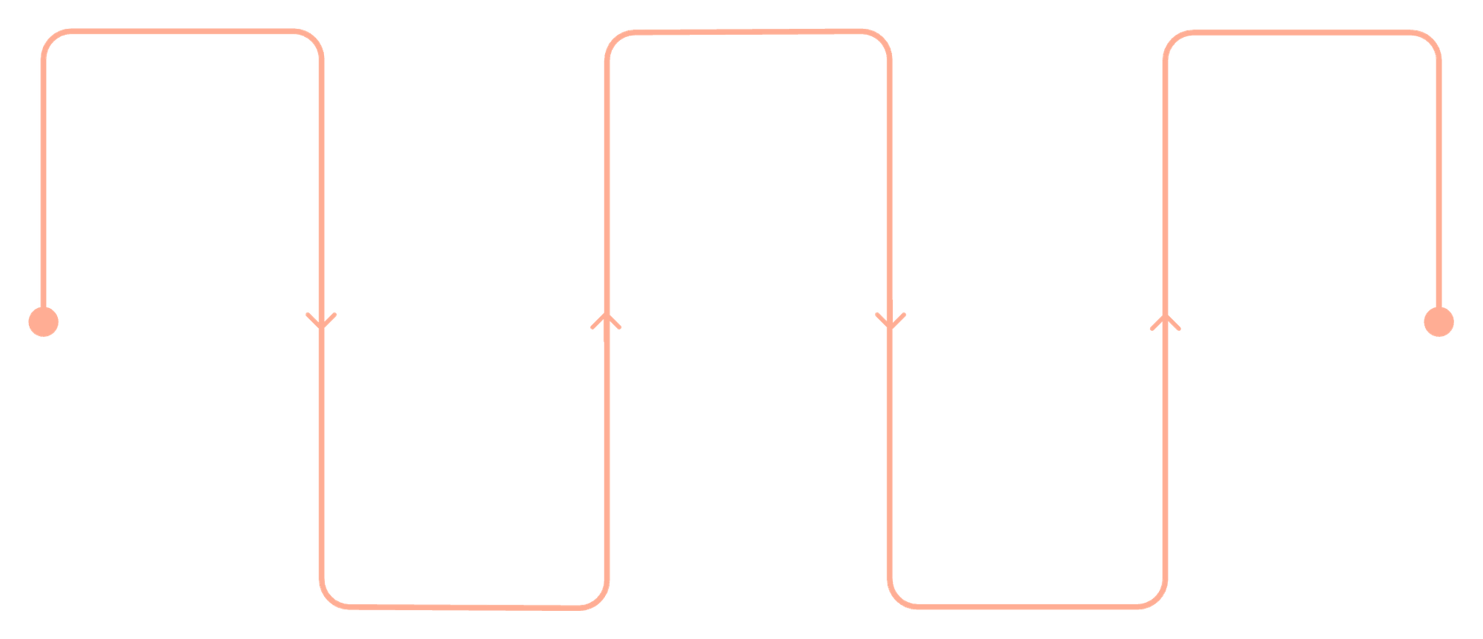
PYTHON
Data Preparation Pipeline
Missing Data
Load Data
Handle Missing Values
Export to Database
37 values imputed using category medians
Import raw tables and files
Persist cleaned data for analysis
Impute or flag gaps in records
Feature Engineering
Clean & Standardize
Age groups and purchase frequency created
Engineer Features
Apply casing, formats, and types
Create age groups and metrics
Standardization
Systematic approach ensuring data quality and consistency for analysis
Snake case columns for consistency

Slide 5

SQL ANALYSIS
Key Business Insights
10 strategic queries uncovering revenue patterns and customer behavior

Slide 6
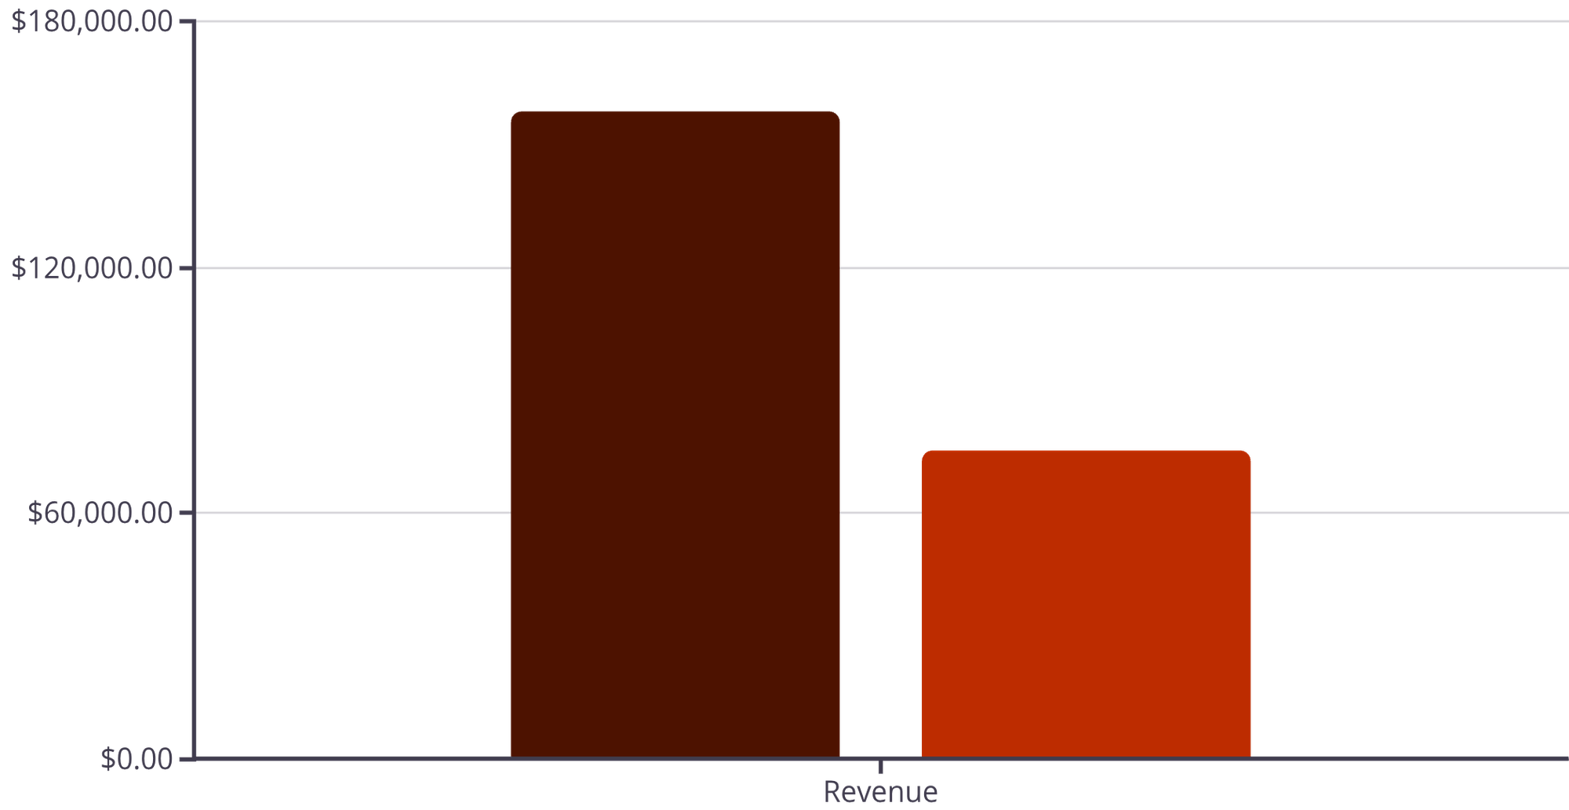
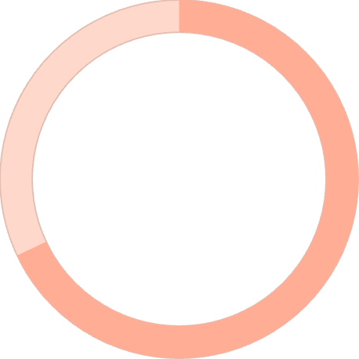
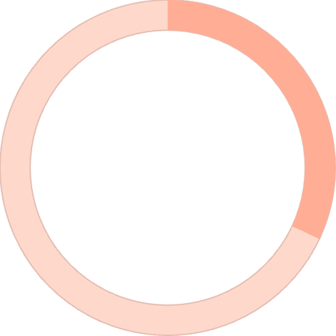
Revenue & Customer Patterns
Male
Female
Gender Revenue Gap
Male customers generate 2.1x more revenue than female customers
68%
32%
Male Revenue
Female Revenue

Slide 7


Customer Segmentation Breakdown
Loyalty Dominates
80% of customers are loyal, showing strong retention
Loyal: 5+ purchases
Returning: 2-4 purchases
New: 1 purchase
New
83
Returning
701
Loyal
3,116

Slide 8



PRODUCT PERFORMANCE
Top Products & Categories
Gloves
Blouse
Jewelry
3.86 average rating - highest rated product
171 orders - most purchased clothing item
171 orders - top accessory category leader

Slide 9
Subscription & Discount Insights
Subscription Impact
27% subscribe, but spending is similar across groups
73%
27%
Non-Subscribers
Subscribers
$59.87 avg spend
$59.49 avg spend
Key Finding: 839 customers used discounts but spent above average - smart shoppers maximizing value

Slide 10




ACTION PLAN
Strategic Recommendations
Boost Subscriptions
Promote exclusive benefits to grow 27% subscriber base
Loyalty Programs
Reward repeat buyers to strengthen 80% loyal segment
Targeted Marketing
Focus on high-revenue age groups and express shipping users

